Slide 1
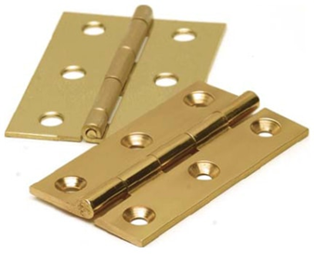
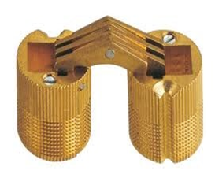
Basic Hinges.
Definition : A hinge is a moving joint
Different types of hinges
1. Butt or Mortise hinge
-It is used for locks, windows, cabinets etc.
2. Barrel hinge
- It is used for gates.

Slide 2
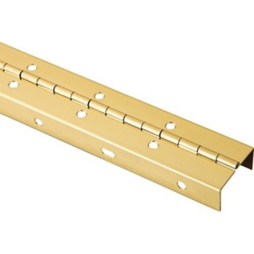
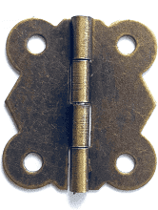
3. Piano hinge
- It is used for cover.
4. Butterfly hinge
- It is used for boxes, and cabinets of general furniture.

Slide 3
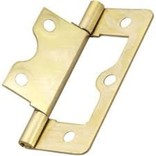
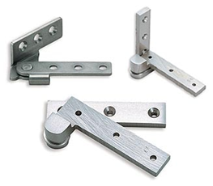
5. Flush hinge
- It is used in cupboards and doors.
6. Pivot hinge
- It is used in overlays doors.

Slide 4
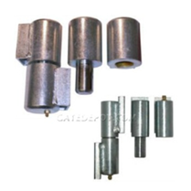
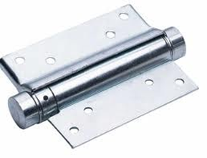
7. Bullet hinge
- It is used in heavy doors.
8. Spring hinge
- It is used where doors are required to close on their own.

Slide 5
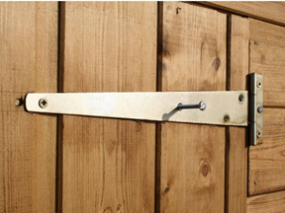
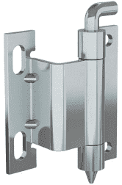
9. Stable hinge
- It is used in big heavy doors.
10. Concealed hinge
- It is used where doors are required to close on their own.
Demonstration Video :
-
Feedback : Activity :

Slide 6

Kwa Thema Skills School
Subject : Maintenance Marks: 10
Grade : Year 2 Time : 30mins
Date :
Question:1
Name the following hinges.
1.__________________ 2.______________________
3.___________________ 4. ______________________

Slide 7
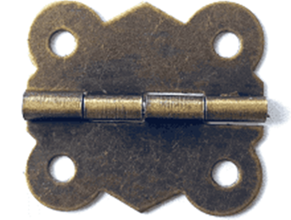


5. _________________ 6. ____________________
7. __________________ 8. ___________________
9. __________________ 10. ___________________
(10)

